Slide 1
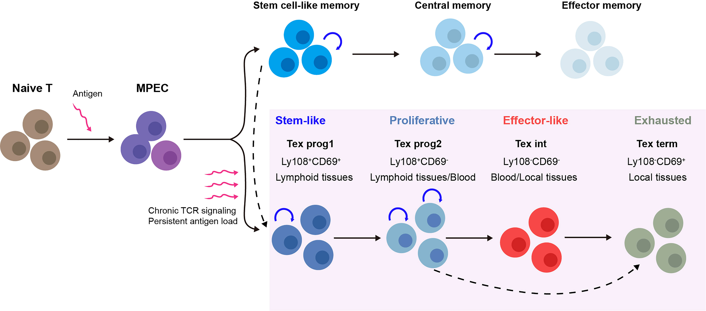
a
Acute response
Chronic response
Naive
Effector differentiation
Loss of maintenance potential
Central
memory
Progenitor
exhausted
Terminal
effector
Terminal
exhausted
b
Central memory
Effector memory
Terminal effector
Acute response
Ag
Ag
Naïve
T cell
CD62L+
KLRG1-
CD62L-
KLRG1-
CD62L-
KLRG1+
Ag
Progenitor
exhausted
Intermediate
exhausted
Terminal
exhausted
Chronic response
PD-1+
TCF1+
TIM3-
PD-1+
TCF1-
TIM3-
PD-1+
TCF1-
TIM3+

